Slide 1
Comparing AI-Based and Manual Photo Editing
A Research Overview by Kledi Azzopardi

Slide 2


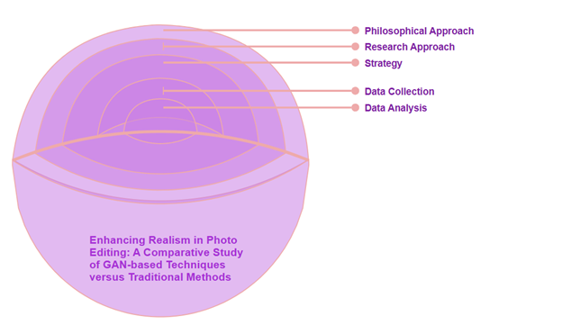
Research Goal
Compare AI tools (GANs, VAEs) with Photoshop
Focus on realism, structure and editing speed

Slide 3
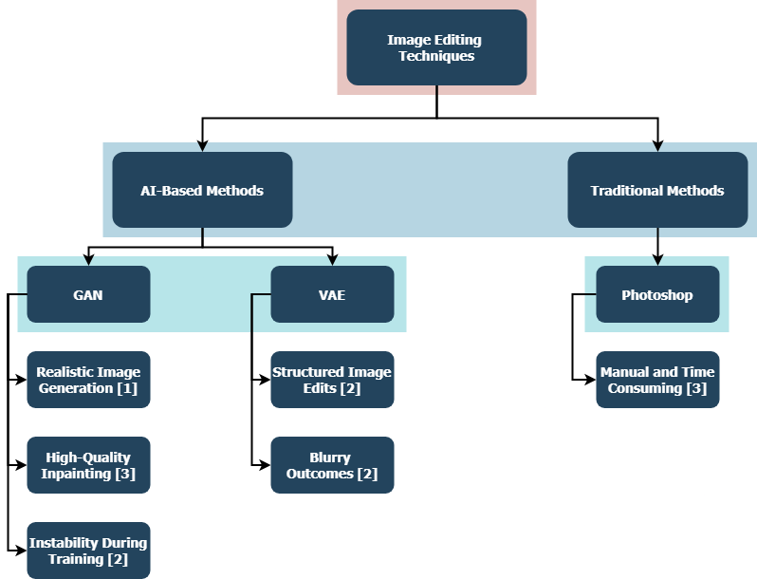
Literature Map
Visual Overview | Map Focus
Diagram showing relationships between GANs, VAEs and Photoshop | GAN: Realism, detail
Highlights strengths, weaknesses and research gap | VAE: Structure, control
 | Photoshop: Manual precision
 | Gap: No clear comparison between AI and manual editing

Slide 4
Methodology
Process Followed
Tools Used
Datasets
Based on the Research Onion model
Experimental comparison approach
Photoshop
GAN-Control
AOT-GAN
CelebA (faces)
Places2 (general images)

Slide 5
Metrics Used
Quantitative Metrics
Qualitative Feedback
MSE (Mean Squared Error)
SSIM (Structural Similarity)
PSNR (Peak Signal-to-Noise Ratio)
Realism
Blending
Detail Preservation

Slide 6
How GANs and VAEs Work
GANs
VAEs
Two-part model: Generator + Discriminator
Great at making images look real
Use latent space for controlled edits
Often blurrier results

Slide 7
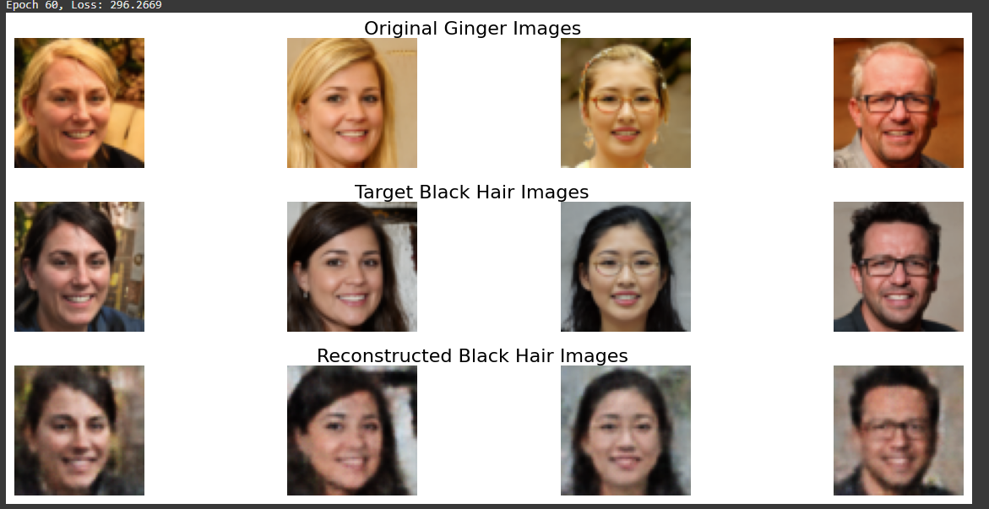
Experiment Setup
Tasked Tested:
Hair Colour Transformation
Logo Removal (Image Inpainting)
Compared Outputs From:
Photoshop
GAN Model
VAE Model
Hair Colour Transformation

Slide 8
Results Summary
GAN
VAE
Photoshop
Close to Photoshop
Much faster and automated
Best control
Least sharp
Most accurate
Best for detail

Slide 9
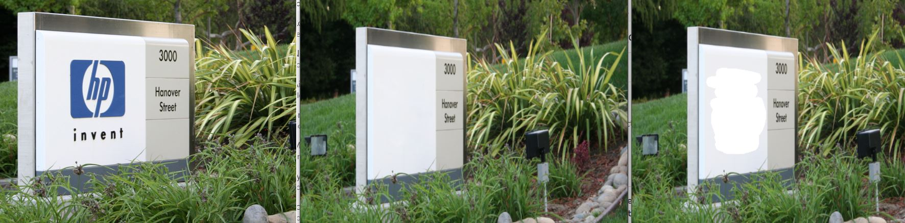
Key Hypothesis
GANs produce more realistic images than Photoshop
VAEs are good for control but less sharp
Merging both could be ideal
AI editing is faster than manual editing
Image Inpainting

Slide 10
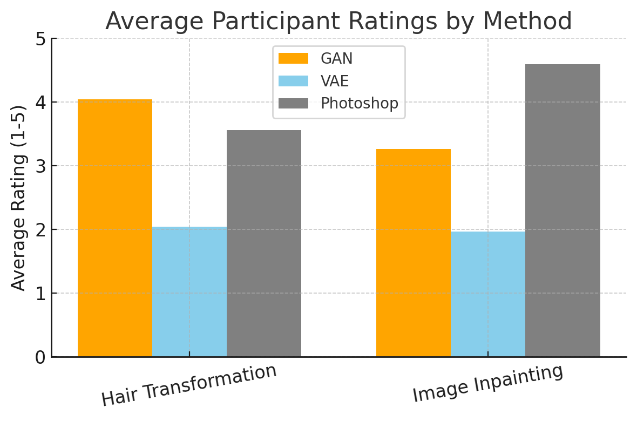
Limitations
Only facial images tested
GANs can be unstable
Human ratings are subjective

Slide 11
Conclusion
Final Takeaways
GANs are a strong Photoshop alternative
VAEs need improvement
AI editing saves time and shows promise
Future Work
Test on more image types
Try combining GANs and VAEs

Slide 12
Thank You

